Slide 1

Fracture test – validation of design #just-for-fun
See Canvas playlist for Chapter 8
https://youtu.be/Ai2HmvAXcU0
Boeing 777 Wing Test

Slide 2
Creep
Creep is deformation that proceeds gradually with time. Such behavior is more prevalent at higher temperatures. In crystalline
materials (metals and ceramics) it becomes significant above 0.3 to 0.6T_{m}, depending on the material, and it occurs in polymers at room temperature.
Creep rupture occurs when a material gradual tears apart as a result of excessive creep deformation.

Slide 3
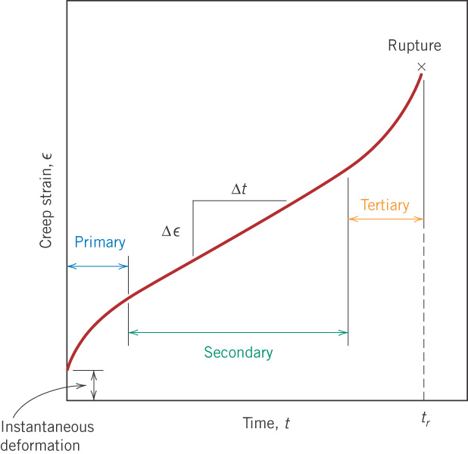
c09f35
Stages of creep
In a creep test at a given temperature, stress is held constant and the increase in strain is measured.

Slide 4
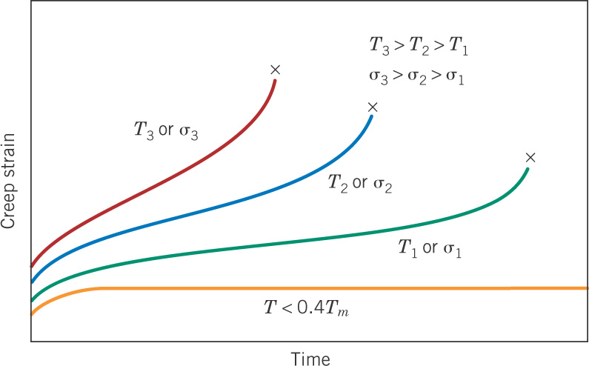
c09f36
Trends with temperature and stress

Slide 5
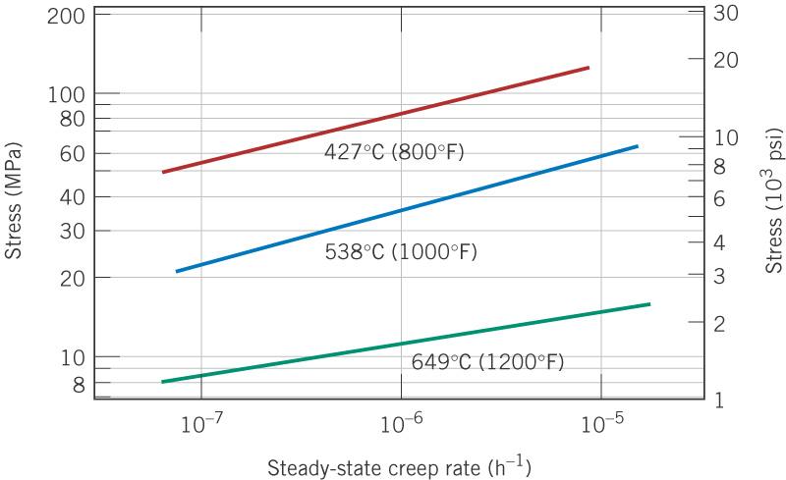
c09f38
Stress vs. creep rate curves
nickel alloy

Slide 6
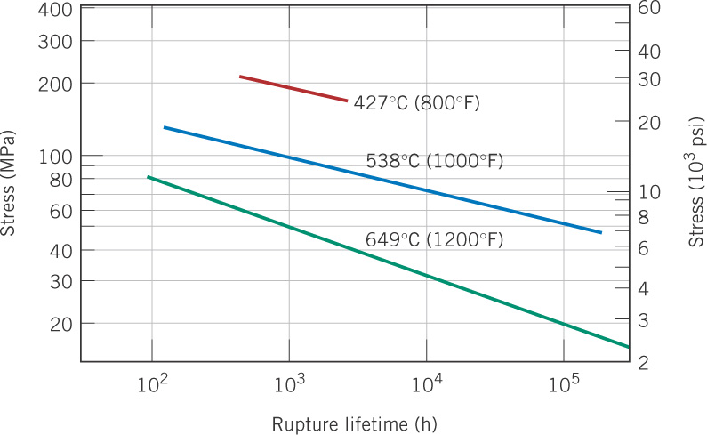
c09f37
Stress vs. rupture life curves
nickel alloy

Slide 7
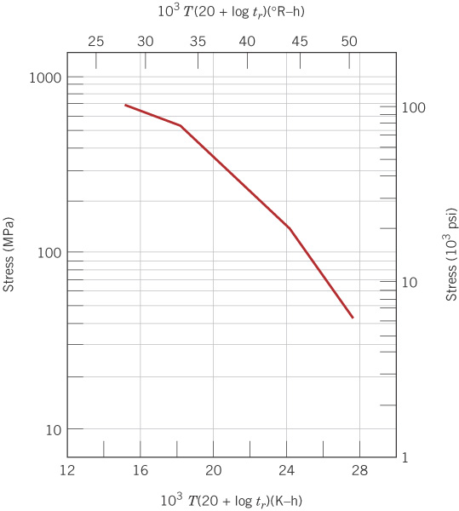
c09f39
Larsen-Miller plot
From tests done at various stresses σ and temperatures T, each giving a rupture time t_{r} , plot σ versus P_{LM}, where:
t_{r} in hours, σ in MPa,
T in kelvin, K = °C + 273
Horizontal scale:
P_{LM} = 12,000, 16,000, etc.

Slide 8
A Larsen-Miller parameter plot gives stress as a function of the quantity P_{LM} that combines temperature and rupture time into one variable. Given such a plot, if any two of t_{r} , σ, and T are known, the third one can be calculated.
t_{r} in hours, σ in MPa, T in Kelvin, K = °C + 273
Rather than reading a graph, it is convenient to fit the data to a
polynomial as follows

Slide 9
Example fitted data
C, log (h) | b₀ | b₁ | b₂ | b₃
17 | 38,405 | −8206 | 0 | 0

Slide 10
Another example
C, log (h) | b₀ | b₁ | b₂ | b₃
20 | 116,400 | −120,500 | 53,460 | −8,188

Slide 11
Design Example 9.2
Alloy S-590 is subjected to a stress of 140 MPa at 800°C. Estimate the time to creep rupture.
Solution: Use the data fit just given to calculate the P_{LM} value for the given stress, and from this and the given temperature, calculate the rupture time.
C, log (h) | b₀ | b₁ | b₂ | b₃
17 | 38,405 | −8206 | 0 | 0

Slide 13
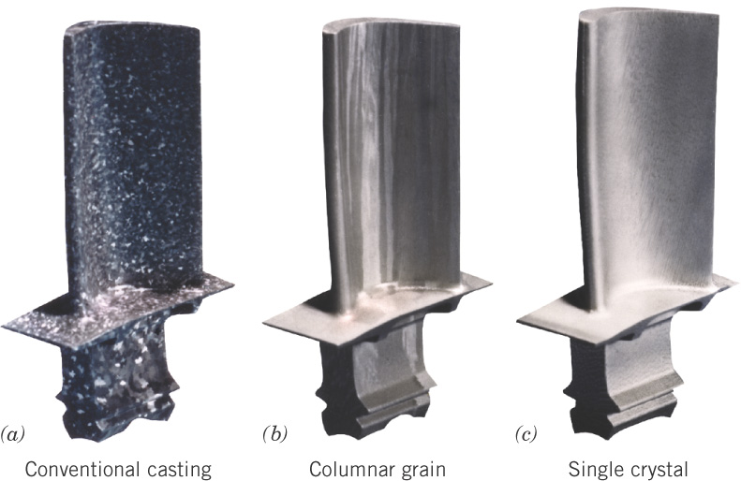
c09f40
Gas turbine blades
At relatively low stress but high temperature, creep occurs by vacancy diffusion as enhanced by grain boundaries. Hence, larger grain size is beneficial.

Slide 14
The End

